Slide 1
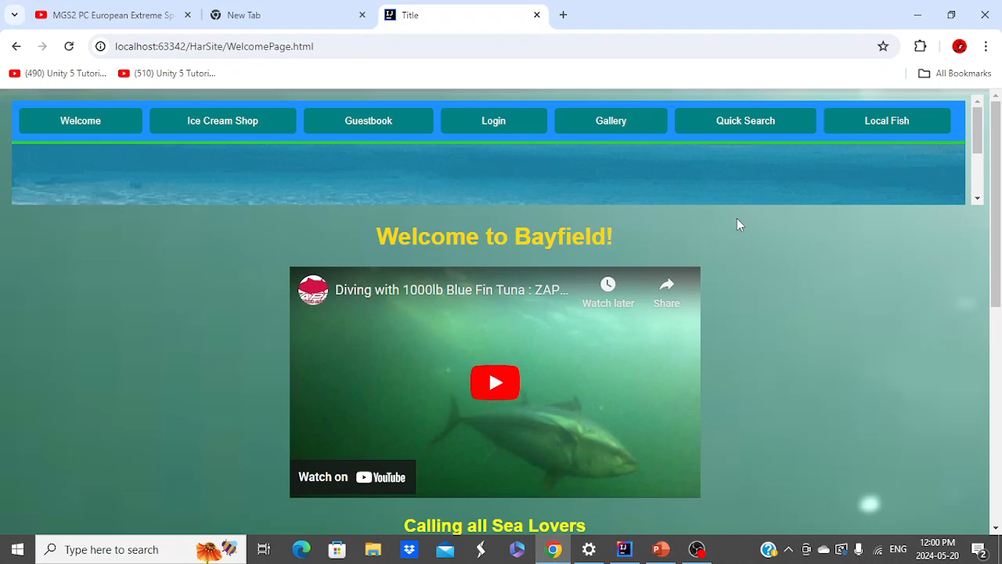
In this video, you see a test of the video that is made for the general entry page. This general entry page contains youtube videos, but instead we could encorporate the general info, fee info, and contact info, with some videos for attraction (just an idea)

Slide 2
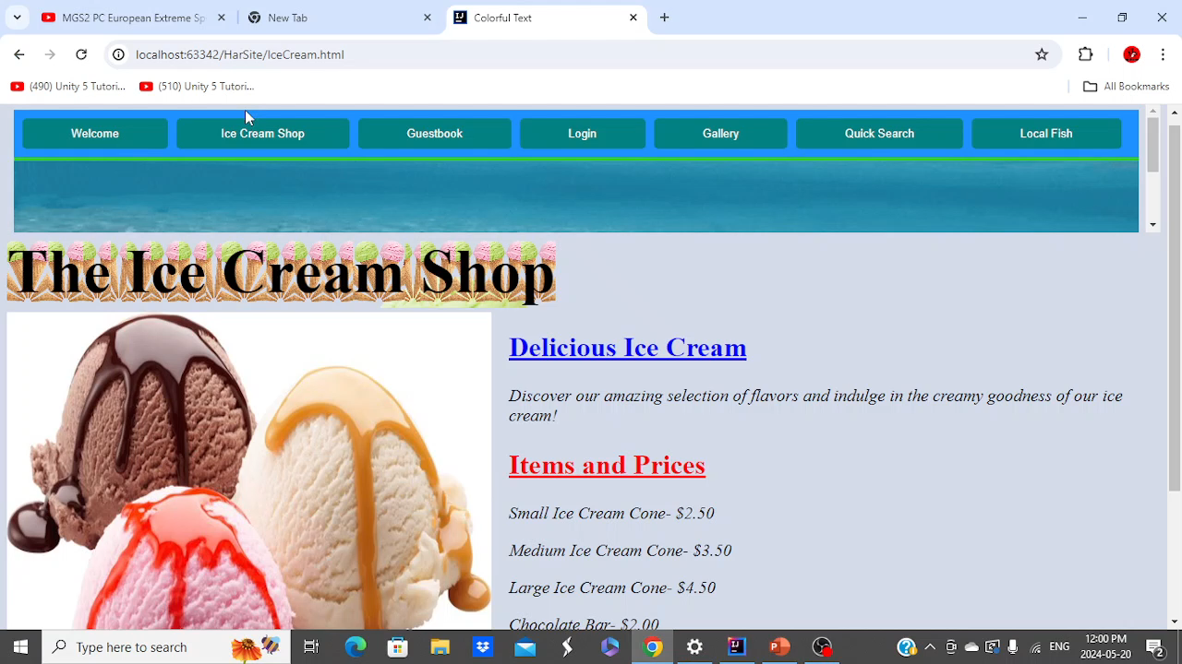
This is the ice cream shop (general information for summer prices) It contains the information about the current ice cream prices. (it could be made more graphically better)

Slide 3
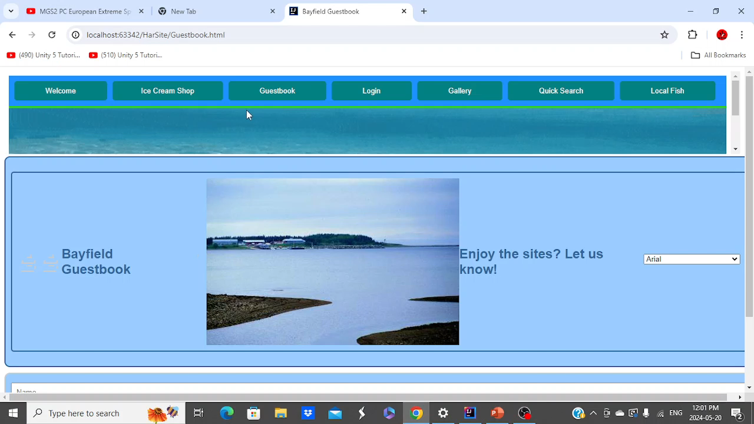
This is the site’s guestbook. It could contain comments about comments about the wharf. We can make it encorporate into the experimental login system, to make use of administration features of the sites back end resources.

Slide 4
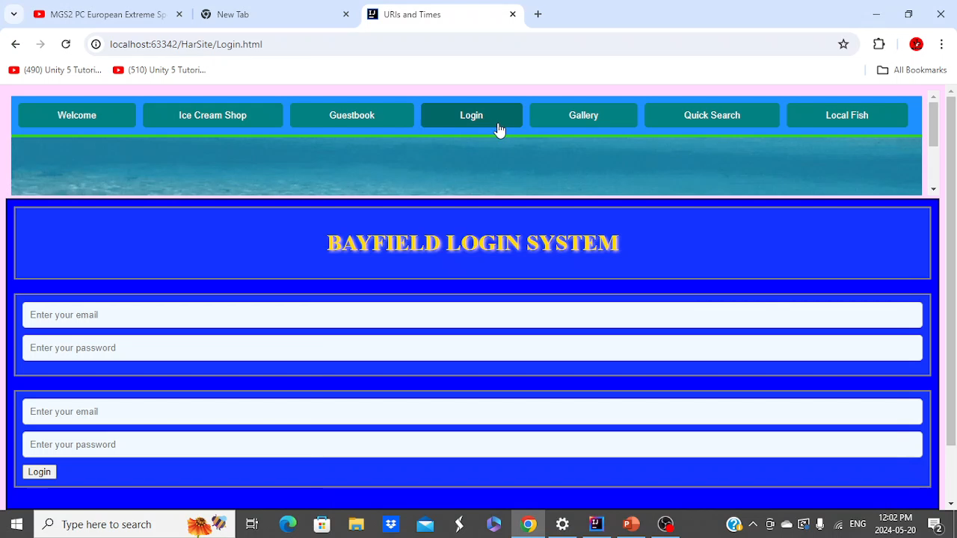
This is the harbour authority login system. It would make the information contained via a site login that links with the backend database on payments, gallery access, guestbook. It makes it so the administration has authority over what is posted, the information for who paid, and also picture authorization (allowing someone to post a picture)

Slide 5
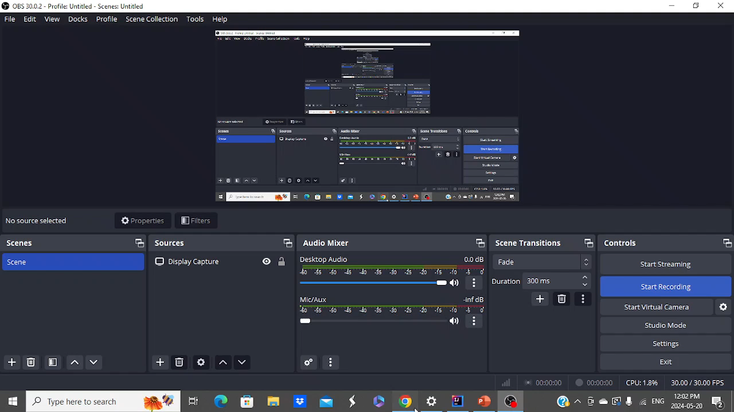
Though there is not extreme presentation here, take in mind it requires a central server to put the files up to administration (for remote allocation via the login). It would be saved on the backend of the website, but not much presentation is made here.

Slide 6
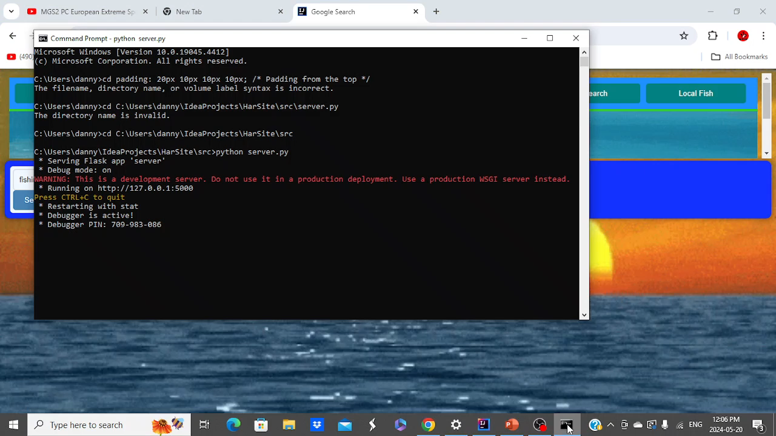
Experimental Version: This is for quick search results via google that gives separate webpages that show access. It would require further refining. (Running on a development server- which is applied to the domain)

Slide 7
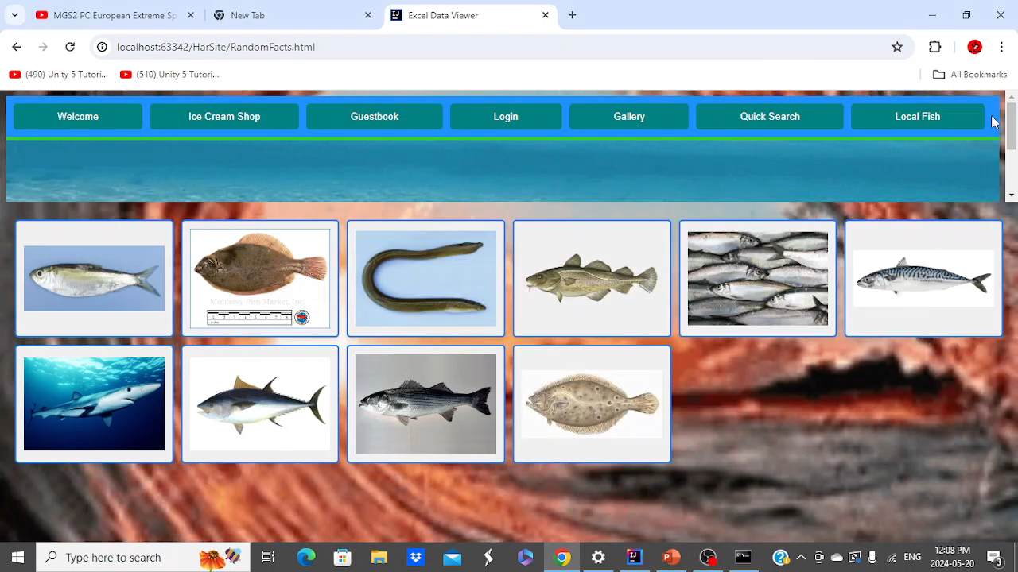
This pages is dedicated to the fisherman’s knowledge. It is based on the knowledge of fish on the bay from a government database. We would like to know everything about the bay as the young fishermen that are exploring the bay!

Slide 8
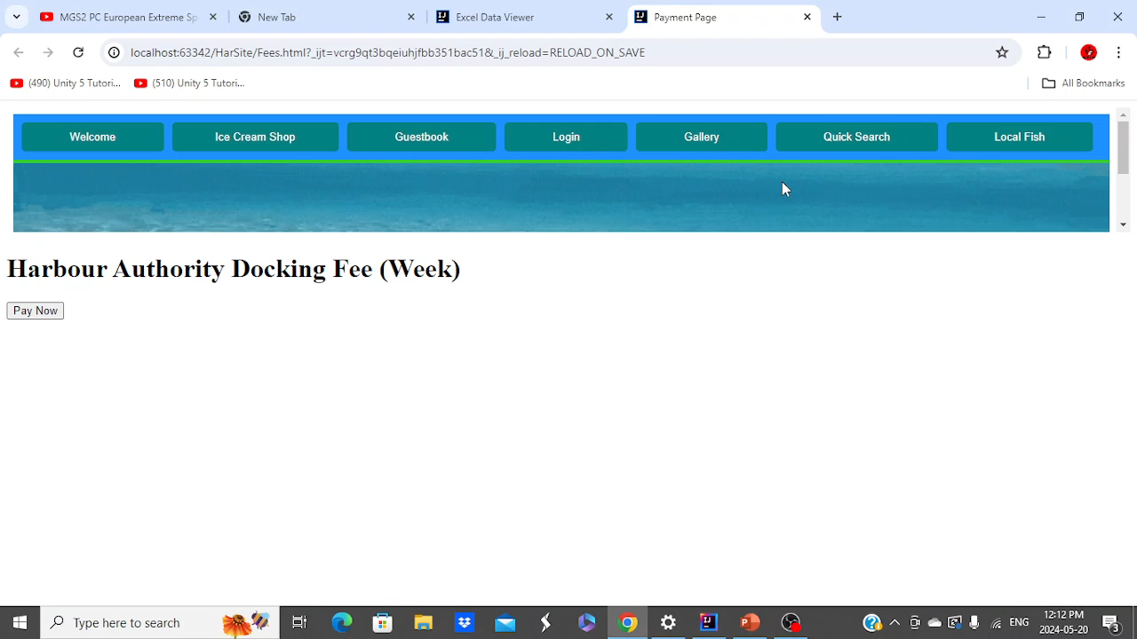
This is an example of a payout page. It contains a 3.5% charge per credit card perchase with a small fee (less than a dollar) via dealing with a credit card server so credit cards are not required, but just the names of fishermen/ pleasure craft drivers). Fees will be included, ontop of the original fee. (for ex: fee of 35 dollars is taxed up for 1.08 totalling 36.08). Unforunately, it is safest to deal with a server so it can be 2 factor authenticated for safest concealment. (which should be done on a separate email with the president’s phone for authentication of said account). Stripe is used for this example.

